Slide 2
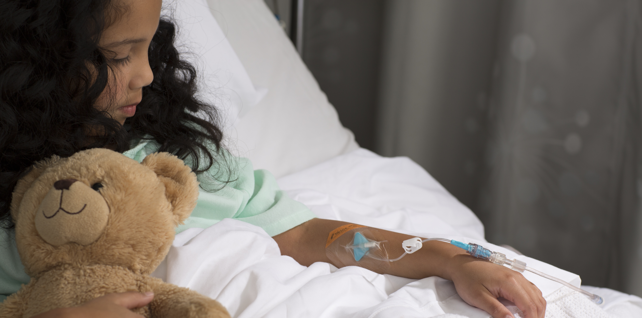
BD PosiFlush™ Pre-Filled Syringes
November 2017
BECAUSE SO MUCH IS ON THE LINE

Slide 3
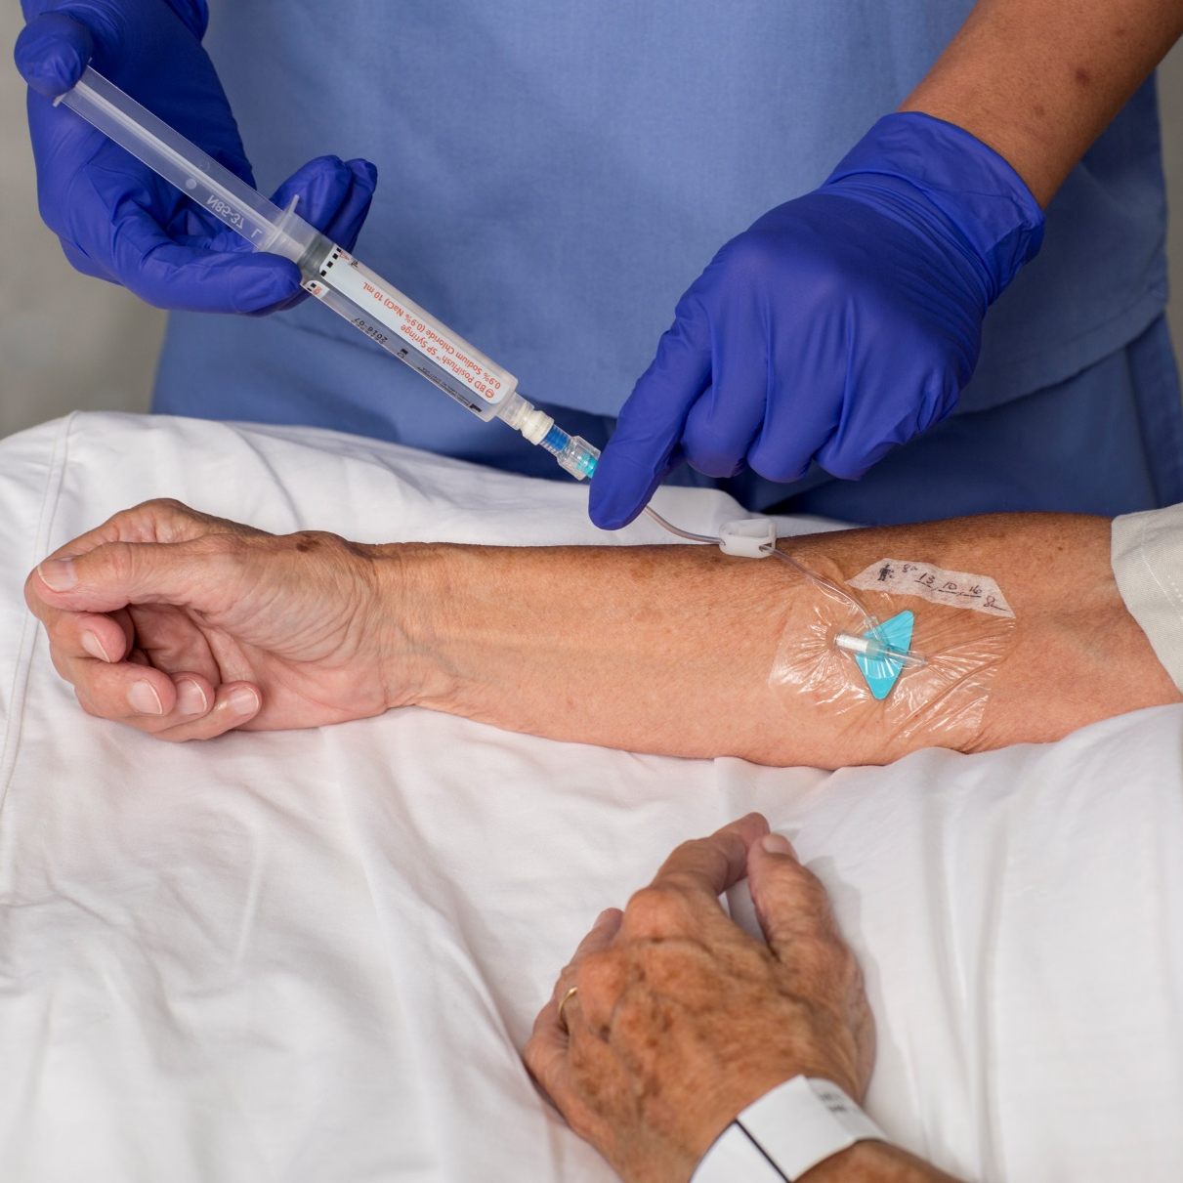
PATIENT SAFETY IS OF UTMOST IMPORTANCE
INFECTION
PHLEBITIS
OCCLUSION
DISLODGEMENT
IV Catheter-Related Complications Compromise Care
EXTRAVASATION
Almost
COMPLICATIONS AND THE RESTARTS THEY REQUIRE
Are painful and risky to the patient
Can delay treatment and extend length of stay
Can impact patient satisfaction and affect the reputation of the provider
Can lead to increased costs in product usage and lost efficiency
of all patients
admitted to a hospital receive a vascular access device¹
90%
1 in 2
patients experience a IV catheter-related complication¹
Notes:
Background of IV use in a Clinical Setting – Supporting text being read with slide
“Intravenous catheter placements are the most common invasive hospital procedure worldwide; 90% of hospitalized patients receive IV therapy and nearly 50% of IV catheters experience a complication that results in the catheter being pulled before its intended dwell time. The most common complications are dislodgement, occlusion, phlebitis and CRBSIs. All of these have a negative effect on the patient and come at a cost to the healthcare provider.” ¹

Slide 4
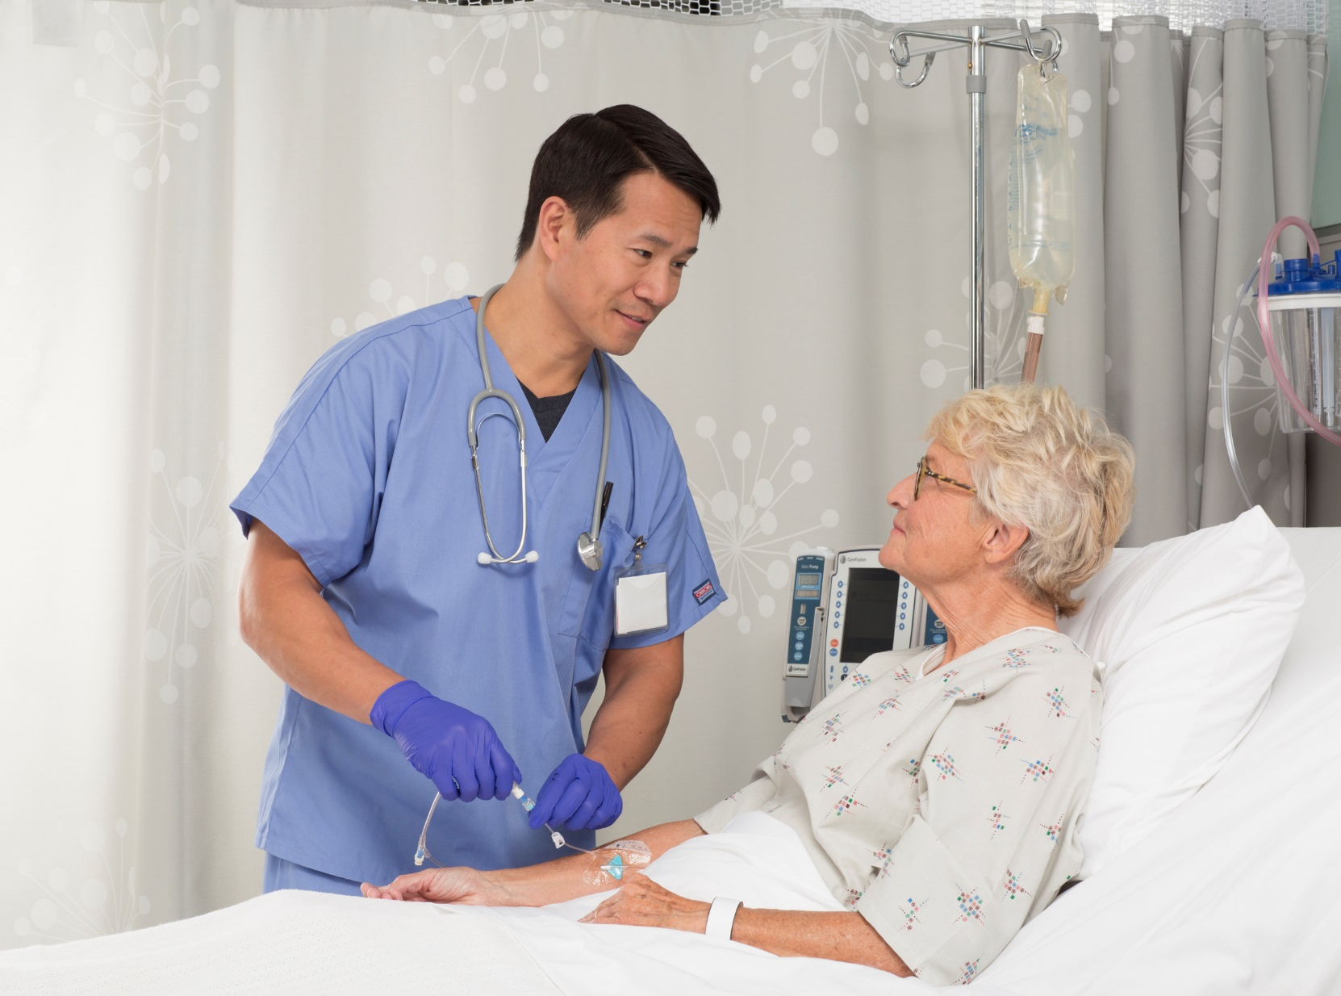
USING A PRE-FILLED FLUSH SYRINGE CAN HAVE A BIG IMPACT ON PATIENT SAFETY
UP TO 263 TIMES
Over their average lifespan, catheters are flushed regularly²
PIVC: 4
CVC: 33
HD: 263
BUT NOT ALL PRE-FILLED FLUSH SYRINGES ARE CREATED EQUAL
Manufacturing process (including recall history), supply consistency and syringe design should be considered when evaluating the pre-filled flush that will be used to assess, clear and lock your patients’ IV catheters
Syringe solutions are flushed directly into the patient’s bloodstream. As a result, any defect in product integrity or sterility has potentially tragic consequences

Slide 5
QUALITY ISSUES
IN MANUFACTURING CAN HAVE A PROFOUND
EFFECT ON PATIENT SAFETY, INCLUDING INFECTION
OR DEATH
When Manufacturing Excellence is Not Met, It Can Have Potentially Fatal Consequences
Contaminated prefilled saline flush syringes manufactured by Nurse Assist may have caused more than 164 bloodstream infections across several states in 59 healthcare facilities… in total, 7 patients diagnosed with the infection have died ³
Center for Disease Control, April 2017

Slide 6
QUALITY ISSUES
IN MANUFACTURING CAN HAVE A PROFOUND
EFFECT ON PATIENT SAFETY, INCLUDING INFECTION
OR DEATH
When Manufacturing Excellence is Not Met, It Can Have Potentially Fatal Consequences
Excelsior pre-filled flush syringes subject to a Class 1 recall due to the potential for leaking or loss of sterility, which could cause a bloodstream infection, resulting in serious injury or death ⁴
Medscape, October 2010

Slide 7
QUALITY ISSUES
IN MANUFACTURING CAN HAVE A PROFOUND
EFFECT ON PATIENT SAFETY, INCLUDING INFECTION
OR DEATH
When Manufacturing Excellence is Not Met, It Can Have Potentially Fatal Consequences
Pre-filled syringes from a contaminated lot made by AM2PAT have since been linked to four deaths and 162 illnesses in the US ⁵
Chicago Tribune, June 2009

Slide 8
QUALITY ISSUES
IN MANUFACTURING CAN HAVE A PROFOUND
EFFECT ON PATIENT SAFETY, INCLUDING INFECTION
OR DEATH
When Manufacturing Excellence is Not Met, It Can Have Potentially Fatal Consequences
A number of Monoject pre-filled flush syringes were filled with water but not subjected to the autoclave sterilization process. If non-sterile fluid is administered there is a health risk of life-threatening infection to the blood stream or other areas ⁶
US Food and Drug Administration, June 2013

Slide 9
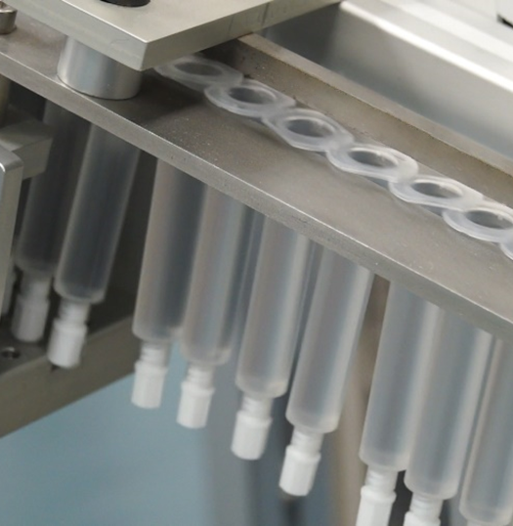
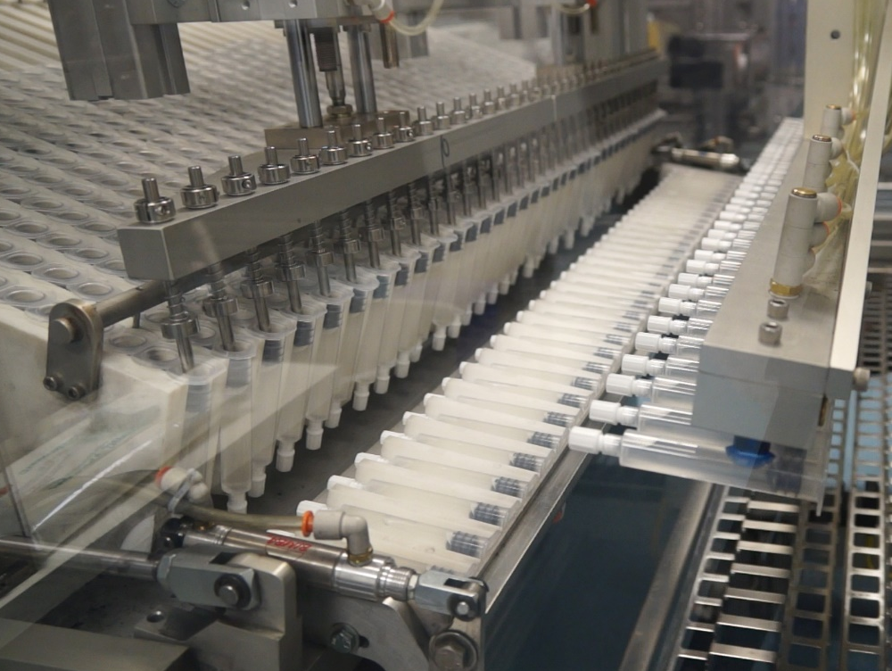
BD’S FULLY-AUTOMATED MANUFACTURING PROCESS ELIMINATES THE HUMAN TOUCH ASSOCIATED WITH A MANUAL PROCESS, WHICH MAY HELP REDUCE POTENTIALLY LIFE THREATENING CONTAMINATION
One Single Source:
Unlike some other pre-filled flush syringes, BD PosiFlush™ is manufactured using a fully automated, end-to-end sterile manufacturing process from components to formulation to filling to packaging.
BD: Automated Manufacturing
Single-Sourced Components and Formulation
BD syringes
BD’s own saline
No Human Interaction
From start to finish NO human hands touch the product
Closed System Environment

Slide 10
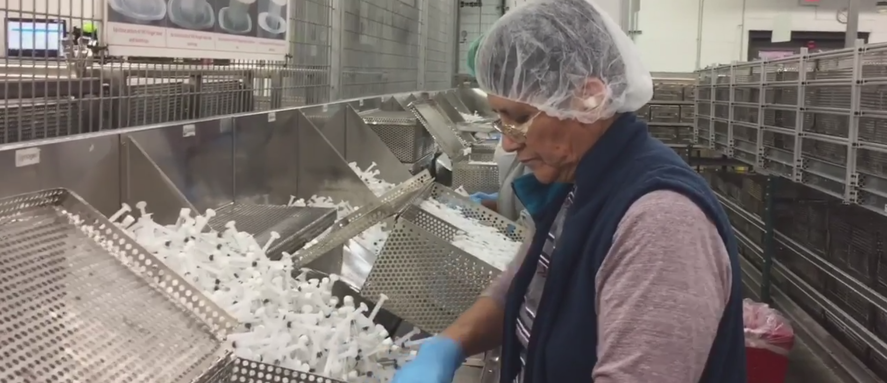
OTHER MANUFACTURING PROCESSES INTRODUCE A HIGHER FREQUENCY OF HANDS TOUCHING THE PRODUCT, POTENTIALLY INCREASING THE RISK OF LIFE THREATENING CONTAMINATION
3rd Party Sourcing:
Unlike BD PosiFlush™, other pre-filled flush syringe manufacturers use a semi-automated or manual manufacturing process, relying on multiple vendors to provide auxiliary products in order to manufacture, and ultimately, deliver the final product to the end user.
Other processes: Manual Manufacturing
Reliant 3rd Party Sourced Components and /or Manufacturing
3rd party saline pre-mixed bag
3rd party syringe components
Human Interaction
Syringe tip filling
Higher frequency of hands touching product
From Asbury Park Press, August 17, 2017 © 2016
Gannett-Community Publishing. All rights reserved. Used by permission and protected by the Copyright Laws of the United States. The printing, copying, redistribution, or retransmission of this Content without express written permission is prohibited." If the Content is printed in a tangible media, the credit notice shall accompany the first or last page the Content appears in. If the Content is reprinted in digital format, the credit notice and a home page link to the website of Asbury Park Press shall appear in close proximity to the Content (before or after). If the Content appears in a film or video program the credit notice shall appear in “rolling credits” at the beginning or end of the program

Slide 11
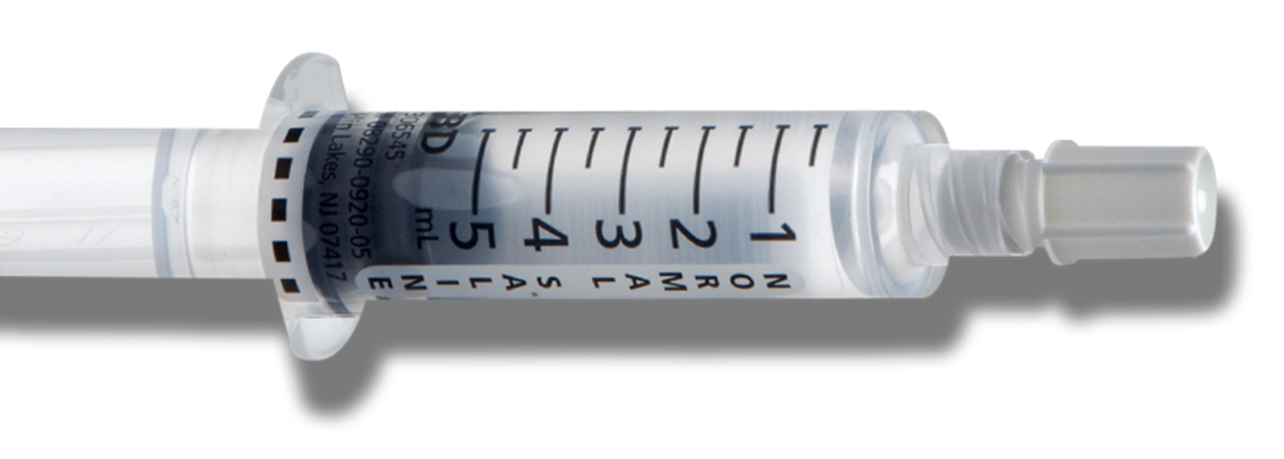
BD’S FULLY-AUTOMATED MANUFACTURING PROCESS ELIMINATES THE HUMAN TOUCH ASSOCIATED WITH A MANUAL PROCESS, WHICH MAY HELP REDUCE POTENTIALLY LIFE THREATENING CONTAMINATION
OVER 8 BILLION BD PosiFlush™ Sterile Path Syringes Produced with NO RECALLS, giving BD the ability to provide guaranteed supply to support your operational needs
Other processes: Manual Manufacturing
Reliant 3rd Party Sourced Components and /or Manufacturing
3rd party saline pre-mixed bag
3rd party syringe components
Human Interaction
Syringe tip filling
Higher frequency of hands touching product

Slide 12
BD STERILE PATH SYRINGES HAVE REMAINED UNAFFECTED THROUGHOUT A MARKET HISTORY OF EXITS AND RECALLS
IV Flush, LLC
1999
2003
2004/2005
2007
2008
FDA suspends distribution due to non-compliance/ status of Rocap’s 510k submission¹⁹
Recalled all pre-filled flush syringe products due to contamination⁷
Class 1 Recall by FDA due to device marketed without 510k clearance and is suspected to be contaminated with P. Fluorescens
36 cases of rapid and delayed-onset P. Fluorescens in 4 states⁷
1.3 million saline flush syringes recalled due to silicone particles floating in the fluid, which may have resulted in phlebitis and/or damage to vital organs such as the brain, kidneys and heart²⁰
Recall conducted due to “heparin-like” substance found Active Pharmaceutical ingredient supplied by SPL (oversulfated chondrotain sulfate)⁷
Am2Pat
2008
2008
2014
2016
AM2PAT begins shipment of syringes labeled “sterile” that had not undergone sterility testing which were linked to bacterial infections
Over 160 cases of bacterial infections, some resulting in spinal meningitis and permanent brain damage; 4 of those infected died, including a 2 year-old²⁰
Recall conducted due to “heparin-like” substances found in their heparin lock flush syringes⁷
Saline bag shortage with Baxter and Hospira begins, increasing the demand for pre-filled flush
Class 1 Recall by FDA due to potential link to Burkholderia cepacia bloodstream infections. ⁷ Over 164 cases in 5 states & 59 healthcare facilities; 7 of those infected have died³
ISSUE – SUPPORTING EVIDENCE
Manufacturer
Distributor
Exit Year
Still on Market (recalled)

Slide 13
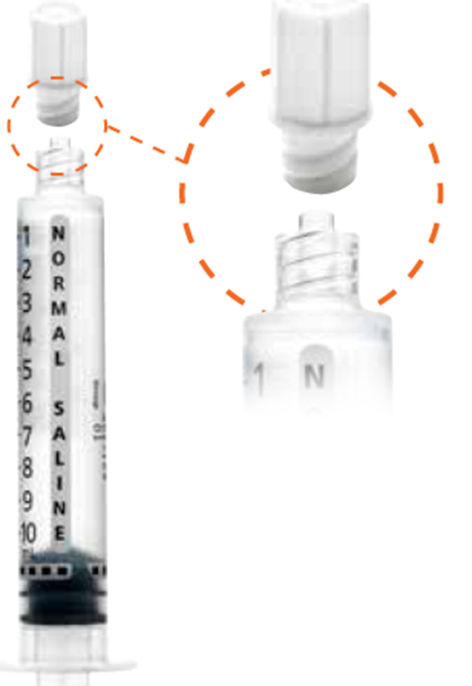
BD’S FOCUS ON THE POSIFLUSHTM DESIGN
DELIVERS BENEFITS TO THE CLINICIAN & PATIENT
BD PosiFlushTM
3 mL syringe
19,75 psi
Standard
3 mL syringe
55 psi
FEATURE
BD Luer Lok™ Tip Cap
Consistent 10 mL Syringe Diameter
Tighter seal for closure integrity helping prevent touch contamination and infection
Unique stubby design allows for a consistent 10 mL syringe diameter which reduces injection pressure, resulting in reduced risk of catheter damage⁸
BENEFIT

Slide 14
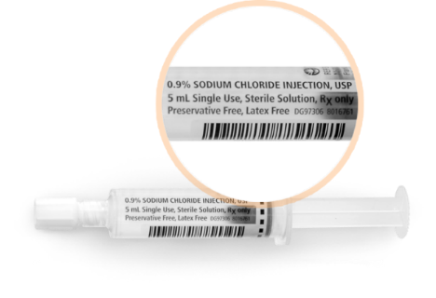
BD’S FOCUS ON THE POSIFLUSHTM DESIGN
DELIVERS BENEFITS TO THE CLINICIAN & PATIENT
BD PosiFlushTM
3 mL syringe
Standard
3 mL syringe
FEATURE
Clear Labeling
Carton Shelf Pack
Supports easy identification of syringe volume, lot number and expiration date as well as distinguishes it from heparin flush
Easy-to-open packaging with 30 individually wrapped syringes in an internal box, simplifying inventory management and allowing for convenient placement on shelves
BENEFIT

Slide 15
BD POSIFLUSHTM IS THE ONLY PRE-FILLED FLUSH SYRINGE
CLINICALLY PROVEN TO DELIVER IMPROVED PATIENT OUTCOMES
BD PosiFlush™ is the only pre-filled flush syringe with evidence to demonstrate CLABSI reduction and improvement in Nurse efficiency vs. manual filled flush syringes
Bertoglio Clinical Study¹⁶ – study showing the effectiveness of BD PosiFlush™ Pre-Filled Flush syringe in reducing totally implantable venous access device associated CRBSI by 57%
Keogh Clinical Study¹⁷ – demonstrates the use of BD PosiFlush™ Pre-Filled Syringes can significantly reduce overall administration time by 49 seconds
Rosenthal Clinical Study¹⁸ – shows the use of split septum connectors and BD PosiFlush™ prefilled flush is cost - effective and associated with a significantly lower CLABSI (65%) rate compared with the use of 3-way stopcocks and manually filled flush

Slide 16
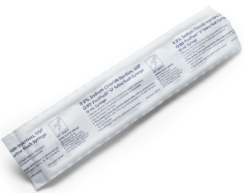
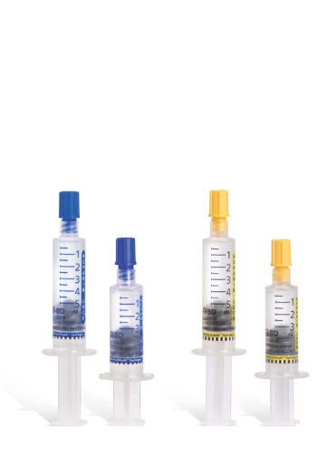
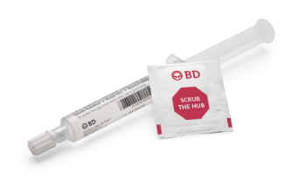
BD OFFERS A COMPREHENSIVE FLUSH PORTFOLIO TO MEET YOUR PATIENT’S NEEDS
The type and size of catheter, age of the patient and type of infusion therapy being given should determine the flush volume being used in order to properly maintain patency and prevent contact between incompatible medications
BD PosiFlush™ Pre-Filled Saline Syringe
May be used on sterile fields and are provided in sterile packages.
Midlines and Centrally dwelling VADs
BD PosiFlush™ SF Normal Saline Syringe
BD provides a complete portfolio, including 3/5/10 mL syringes, sterile field syringes and heparin lock flush syringes to ensure your patients get the customized care they need and deserve
BD PosiFlush™ Heparin Lock Flush Syringe
Intended for maintenance of patency of vascular access devices only
BD PosiFlush™ SureScrub™ Pre-Filled Syringe
Enables clinicians to follow best practices and guidelines for disinfection of needle-free connectors

Slide 17
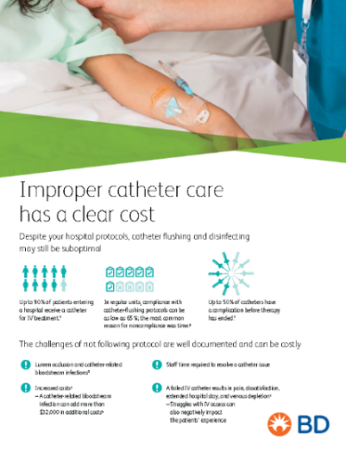
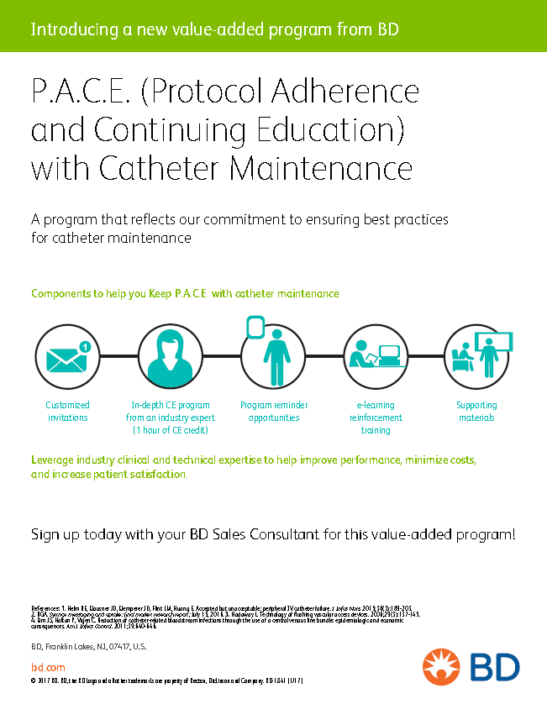
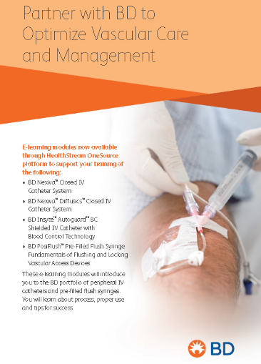
BD IS COMMITTED TO PROVIDING ON-GOING EDUCATION PROGRAMS TO HELP TRAIN CLINICIANS AND ULTIMATELY BENEFIT PATIENTS
Customized in-service training
Clinical skills development
On-demand eLearning modules
Clinical Practice Assessments

Slide 18
Market Conversion Rate
(Manual to Pre-Filled)
Market Timeline
~10%
Pre-BD
PreeFil
Corporation
~20%
1999
~50%
2005
IV Flush, LLC
~75%
2007
Am2Pat
~90%
2017
Recalls
Extinct by recall or disruption
Market Competition
*Recalls in reference to quality issues related to solution
Notes:
Simplified snap shot of the pre-filled flush market evolution dating back to the mid-to-late 1990s
As you go down the pyramid, you’ll notice the pre-filled market conversion increase and on the left, even though it’s not shown, the market price decreases over time but has been stable since 2012
Of course, it’s easy to see that the pre-filled flush market has grown substantially in regards to competition but it is important to note that not every competitor at the top of the pyramid is present on the bottom, with the exception of Excelsior, PosiFlush and the Medefil product
Just a few comments on the competition in general…

Slide 19
WHEN IT COMES TO PATIENT SAFETY,
MANUFACTURING EXCELLENCE & A HIGH QUALITY PRODUCT THAT CLINICIANS TRUST
BD Stands Alone…
Notes:
Simplified snap shot of the pre-filled flush market evolution dating back to the mid-to-late 1990s
As you go down the pyramid, you’ll notice the pre-filled market conversion increase and on the left, even though it’s not shown, the market price decreases over time but has been stable since 2012
Of course, it’s easy to see that the pre-filled flush market has grown substantially in regards to competition but it is important to note that not every competitor at the top of the pyramid is present on the bottom, with the exception of Excelsior, PosiFlush and the Medefil product
Just a few comments on the competition in general…

Slide 20
THANK YOU!

Slide 21
REFERENCES
1
6
Helm R, Klausner J, Klemperer J, Flint L, Huang E. Accepted but unacceptable: peripheral IV catheter failure. J Infus Nurs. 2015 May-Jun;38(3):189-203
"FDA MedWatch – Covidien Monoject Prefill Flush Syringes: Recall – Not Subjected To AutoClave Sterilization Process Or Mismatched Syringe Tip Cap, Syringe Label, Filled Volume And Wrapper.” Vanderbilt University. Vanderbilt University, 20 Aug. 2013. Web. 22 June 2017.
2
Data on File
7
3
"Medical Device Recalls." U.S. Food and Drug Administration. U.S. Food and Drug Administration, n.d. Web. 22 June 2017.
"Healthcare-associated Infections." Centers for Disease Control and Prevention. Centers for Disease Control and Prevention, 19 Apr. 2017. Web. 22 June 2017.
8
Inspections and Audits RSS." FDANews. N.p., n.d. Web. 22 June 2017.
4
Hitt, Emma, PhD. "FDA and Excelsior Medical Recall Prefilled Saline Flush Syringes." Medscape. N.p., 1
9
"Baxter Signs a Definitive Asset Purchase Agreement To Acquire Several Buisnesses From Sabratek Corporation." Login | Evaluate. Press Release, 20 Dec. 1999. Web. 22 June 2017.
5
Jewett, Christina. "Dirty syringes: FDA failed to shut down troubled plant, and family paid price." Chicago Tribune. ProPublica, 7 June 2009. Web. 22 June 2017.

Slide 22
REFERENCES
10
15
Densford, Fink. "ICU Medical, Medline split $59.5 Excelsior Medical buy." MassDevice. N.p., 08 Oct. 2015. Web. 22 June 2017.
The Joint Commission. 2008 National Patient Safety Goal Hospital Program. Available at www.jointcommission.org/patientsafety/nationalpatientsafetygoals.htm. Accessed June 22, 2017
11
16
"AmUSA changes company name to Aquabilti." AmUSA changes company name to Aquabilti | Aquabiliti. N.p., n.d. Web. 22 June 2017.
Bertoglio S, Rezzo R, Merlo FD, et al. Pre-filled normal saline syringes to reduce totally implantable venous access device-associated bloodstream infection: a single institution pilot study. J Hosp Infect. 2013;84(1):85-88.
12
Medtronic. "Physician and Healthcare Payer Information | Medtronic." Newsroom | Medtronic | Medtronic to Acquire Covidien for $42.9 billion in Cash and Stock. N.p., n.d. Web. 22 June 2017.
17
Keogh S. A Time and Motion Study of Peripheral Venous Catheter Flushing Practice Using Manually Prepared and Prefilled Flush Syringes. J InfusNurs.2014;37(2):96-101.
13
"Cardinal Health to Acquire Leading Patient Product Portfolio from Medtronic for $6.1 Billion." Cardinal Health Inc. N.p., 18 Apr. 2017. Web. 22 June 2017.
18
Rosenthal V, et al. Clinical impact and cost-effectiveness of split-septum and single-use prefilled flushing device vs 3-way stopcock on central line-associated bloodstream infection rates in India: a randomized clinical trial conducted by the International Nosocomial Infection Control Consortium (INICC). Am J Infect Control. 2015 Jul 8.
14
Hadaway L. Technology of Flushing Vascular Access Devices. Journal of Infusion Nursing. 2006;29(3):139-140

Slide 23
REFERENCES
19
Corporation, Sabratek. “Sabratek Halts Distribution of Rocap.” PR Newswire: news distribution, targeting and monitoring, 23 Nov. 1998, www.prnewswire.com/news-releases/sabratek-halts-distribution-of-rocap-77525497.html#.
20
Nguyen, Christina JewettDan. “Timeline: How Contaminated Syringes Got From Factory to Patients.” ProPublica, 6 June 2009, www.propublica.org/article/timeline-am2pat.

Slide 24
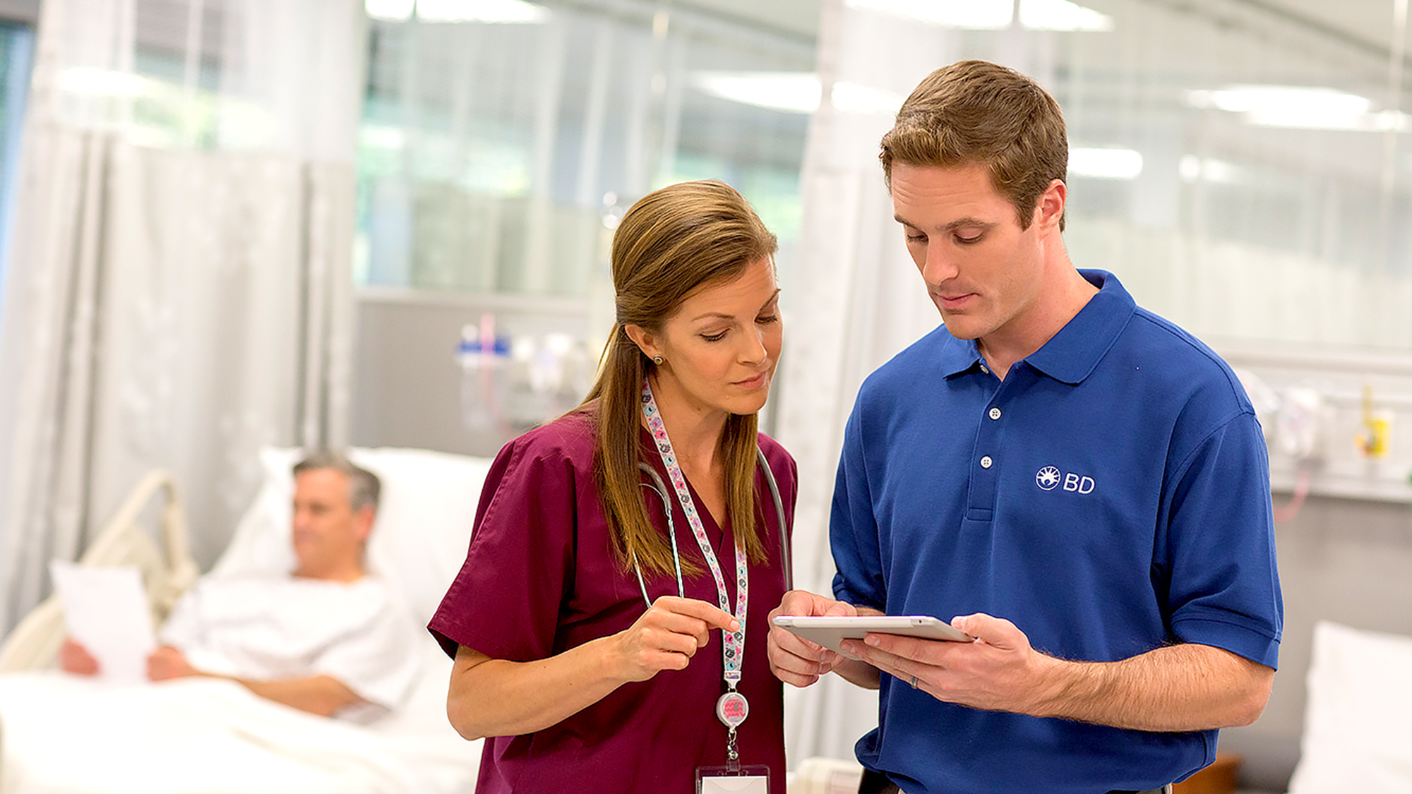
APPENDIX

Slide 25
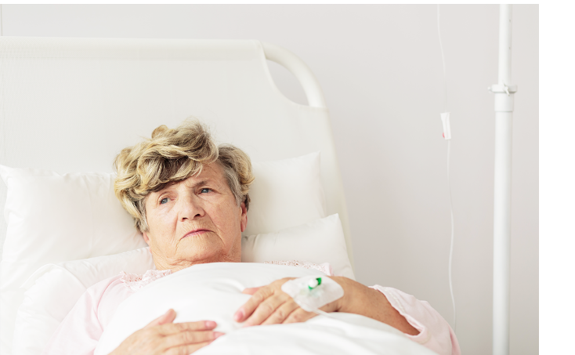
QUALITY ISSUES
IN MANUFACTURING CAN HAVE A PROFOUND
EFFECT ON PATIENT SAFETY, INCLUDING INFECTION
OR DEATH
Contaminated prefilled saline flush syringes manufactured by Nurse Assist may have caused more than 164 bloodstream infections across several states in 59 healthcare facilities… in total, 7 patients diagnosed with the infection have died ³
Center for Disease Control, April 2017
When Manufacturing Excellence is Not Met, It Can Have Potentially Fatal Consequences
Excelsior pre-filled flush syringes subject to a Class 1 recall due to the potential for leaking or loss of sterility, which could cause a bloodstream infection, resulting in serious injury or death ⁴
Medscape, October 2010
Pre-filled syringes from a contaminated lot made by AM2PAT have since been linked to four deaths and 162 illnesses in the US ⁵
Chicago Tribune, June 2009
A number of Monoject pre-filled flush syringes were filled with water but not subjected to the autoclave sterilization process. If non-sterile fluid is administered there is a health risk of life-threatening infection to the blood stream or other areas. ⁶
US Food and Drug Administration, June 2013

Slide 26
EVEN WITH THE COMPLEX CHANGING-OF-HANDS IN THE PRE-FILLED FLUSH MARKET, BD HAS REMAINED UNCHANGED
Baxter purchased the Rocap pre-filled syringe business along with other assets in December 1999 after Sabratek filed for bankruptcy⁹
Am2Pat
B. Braun was a former distributor of AM2PAT syringes at the time of AM2PAT’s fatal recall
October 2015, ICU Medical, Inc. signs a definitive agreement to acquire Excelsior Medical Corp. ICU also signed a definitive agreement to sell the operating assets of SwabFlush
and the pre-filled saline and heparin flush syringes to Medline¹⁰
Founded by Baxter Healthcare in 2000 and operating under the name AMUSA. Effective September 2015, operating company, AMUSA, changes name to Aquabiliti to better reflect company’s current and future water based products¹¹
In January 2015, Medtronic completes acquisition of Covidien and attains pre-filled flush syringe business. In April 2017, Cardinal Health acquired Medtronic’s patient care, DVT and nutritional insufficiency business¹²
Braun is a current distributor of the Medline product (ZR Syringes)
Cardinal Health is a current distributor of the Medline product (ZR Syringes)
Covidien relies on Medline manufacturing (OEM relationship )for a portion of their pre-filled flush syringes

Slide 27
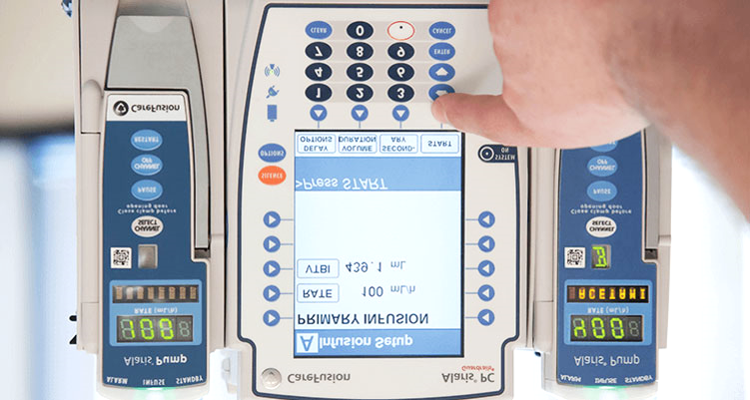
COMPATIBLE PRE-FILLED FLUSH SYRINGES FOR USE WITH THE ALARIS SYRINGE MODULE
Only approved syringes that have been validated and tested by the pump manufacturer are considered compatible. BD 306500 and BD 306504 are approved for use with the Alaris System – No other pre-filled flush competitive syringes have been validated or approved for use.
FDA Communication submitted to ALL syringe pump manufacturers

Slide 28
BD OFFERS COMPLETE VASCULAR ACCESS SOLUTIONS TO
HELP REDUCE COMPLICATIONS ASSOCIATED WITH VASCULAR ACCESS
From Insertion...
To removal...
Evidence based practice & continuing education
Compliance to guidelines, audit & practice reviews
Infection prevention & skin antisepsis
Intended indwell time for therapy
Insertion skill & success
Vascular Access Management
Care & maintenance: patency pre-filled flush
Selecting the right vascular access device
Needle-free connector utilisation
Securement & stabilisation

Slide 29
BD FOCUSES ON
BD PROUDLY SERVES
PRODUCT & SUPPLY
UPMC Presbyterian Shadyside, Pittsburgh
19 OF THE TOP 20 US HOSPITALS
Massachussets General Hospital, Boston
Cleveland Clinic
University of Michigan Hospitals and Health Centers, Ann Harbor
Nebraska
New York-Presbyterian Hospital
University of Colorado Hospital, Aurora
NYU Langone Medical Center
Ireland
Mount Sinai Hospital, New York
Jonhs Hopkins Hospital, Baltimore
UCSF Medical Center, San Francisco
Hospitals of the University of Pennsylvania – Penn Presbyterian, Philadelphia
Spain
Stanford Health Care - Stanford Hospital
Duke University Hospital, Durham, N.C.
3 Global manufacturing plants producing >1B BD PosiFlush™ Syringes annually around the world to ensure supply continuity
Northwestern Memorial Hospital, Chicago
Ronald Raegan UCLA Medical Center, Los Angeles
Cedars-Sinai Medical Center, Los Angeles
Barnes-Jewish Hospital, St. Louis
Thomas Jefferson University Hospitals, Philadelphia
Mayo Clinic Phoenix
Houston Methodist Hospital

Slide 30
Thank you!

